Slide 1


Slide 2
CYBER SECURITY PROJECT PRESENTATION
By,
Chirag Radhakrishna & Chiranjeevi PR
CYBER SECURITY & ETHICAL HACKING BATCH-18

Slide 3
PROJECT OBJECTIVE
To explain the concept of web application penetration testing by identifying the vulnerabilities of a given WordPress server and obtaining the user account(s) and the respective password(s).

Slide 4
What is Web Penetration?
Web application penetration testing is the practice of simulating attacks on a system in an attempt to gain access to sensitive data, with the purpose of determining whether a system is secure.

Slide 5
Stages of Penetration Testing
RECONNAISANCE
REPORTING
EXPLOITATION
VULNERABILITY
ASSESSMENT
SCANNING

Slide 6

SOFTWARE
The software components used are:
Oracle VM Virtual Box
Kali Linux VM
WordPress Server VM

Slide 7
PART 1- FOOTPRINTING

Slide 8
What is footprinting?
It’s the process of gathering data about a certain target, usually for the purpose of exploiting that information to compromise the target.

Slide 9
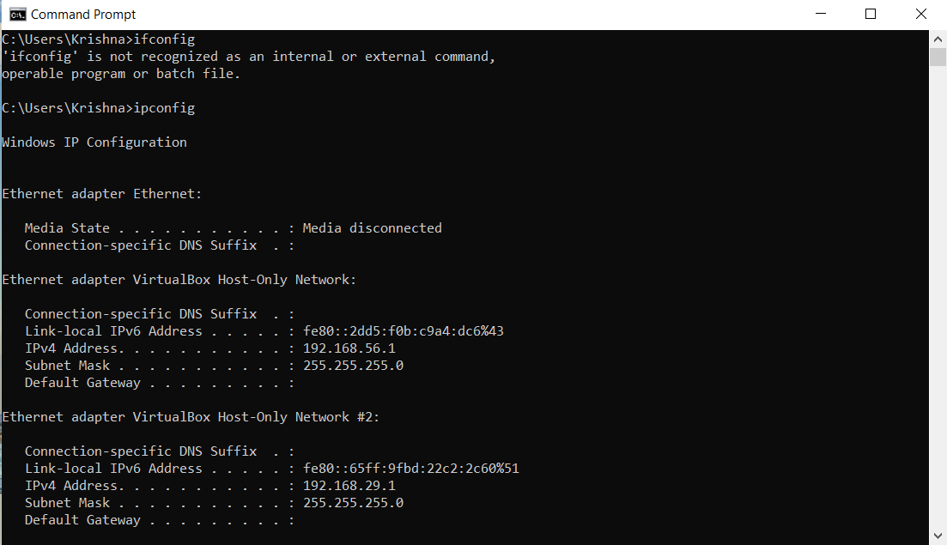
Footprinting using Nmap

Slide 10
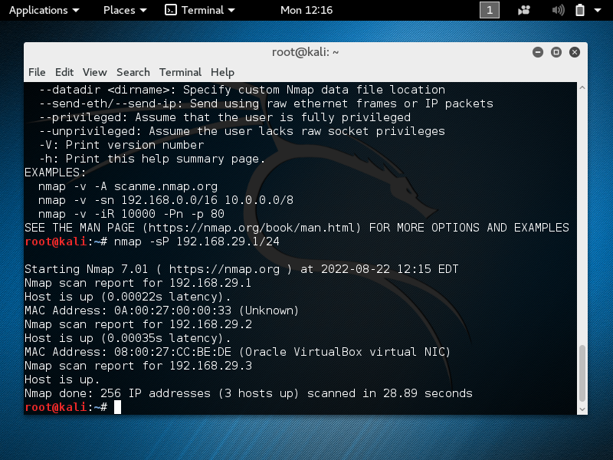
To obtain information about the hosts on the network 192.168.29.1, we use the command:
Nmap –sP 192.168.29.1/24
A total of 3 hosts have been detected.

Slide 11
We can see the number of open ports on a particular host using the command:
Nmap –sS -A 192.168.29.2
192.168.29.2: Is the host for which we try to obtain information.
By running this command, we can obtain information such as port number that is open, state, service and version. Also we can obtain the type of device, the OS it is running, the OS details and trace-routes.

Slide 12
PART 2- WordPress Server and Website

Slide 13
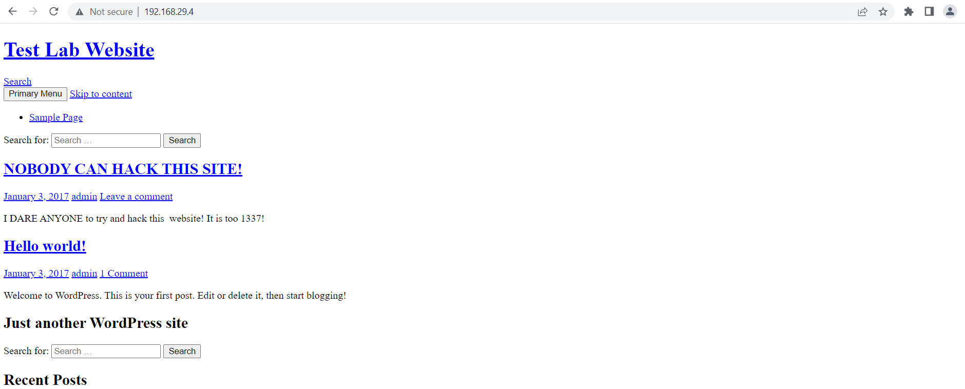
IP address of the server is obtained by running the ifconfig command on the WordPress VM.
The IP address obtained is 192.168.29.4.
Using this address, we are able to obtain the website on our browser.
Hence we are able to generate the website.

Slide 14
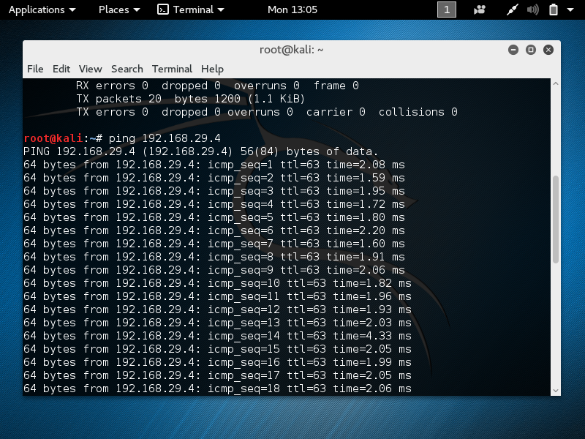
To scan and obtain information about the website and WordPress server, we need to connect the server VM with Kali Linux.

Slide 15
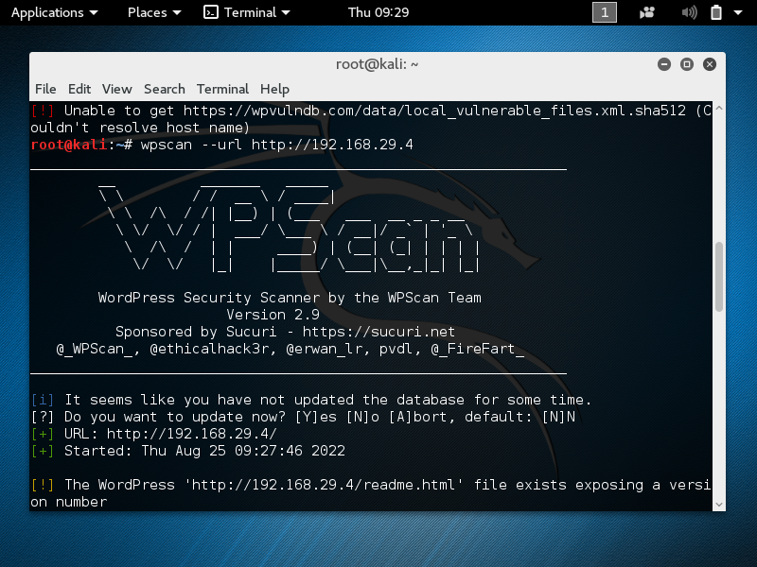
Scanning and vulnerability assessment-
To identify the vulnerabilities, we make use of the wpscan tool.
Command :wpscan - -url http://192.168.29.4

Slide 16
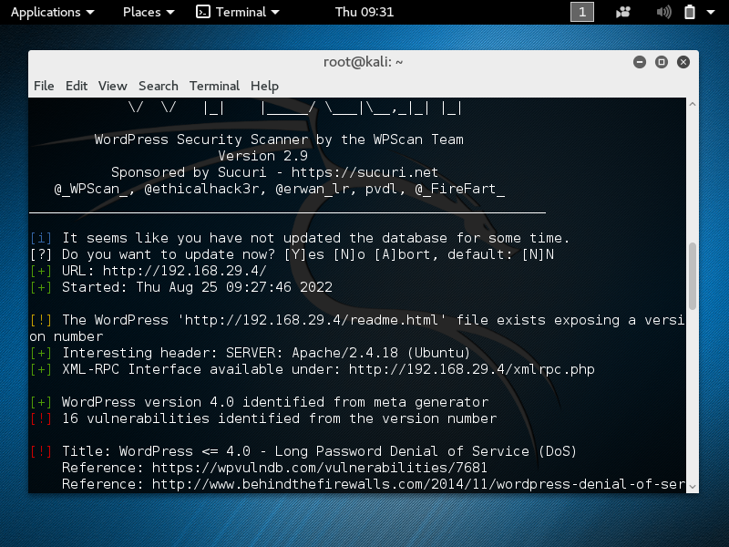
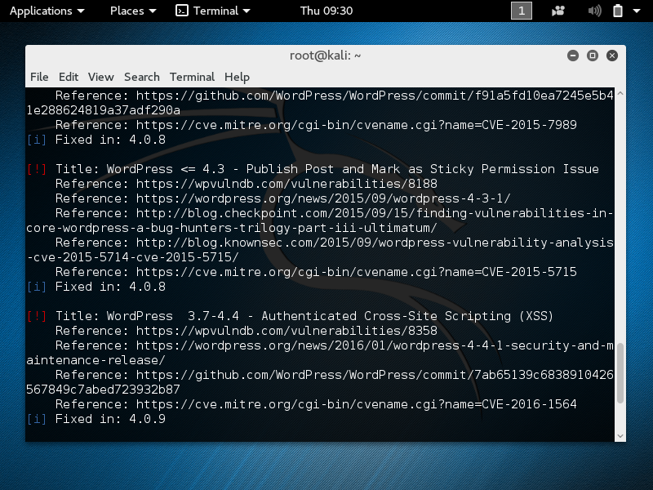

Slide 17
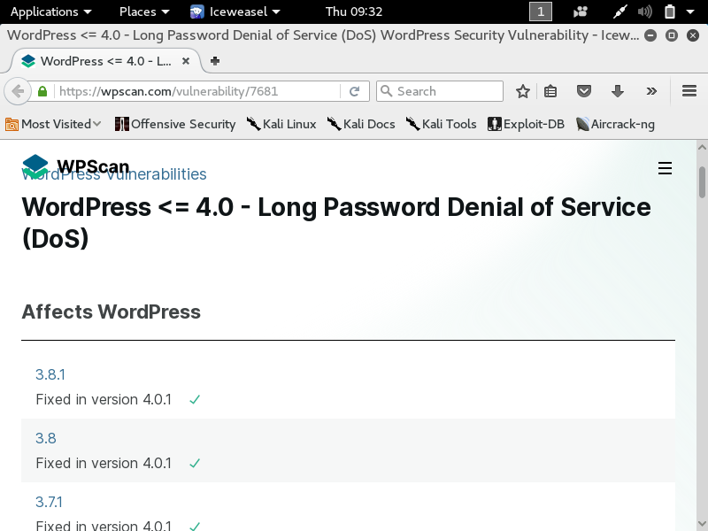
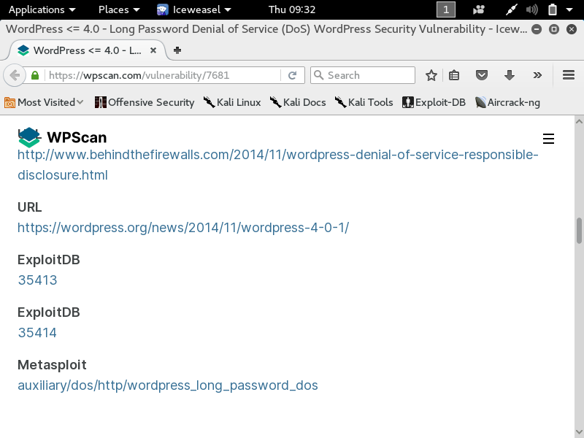

Slide 18
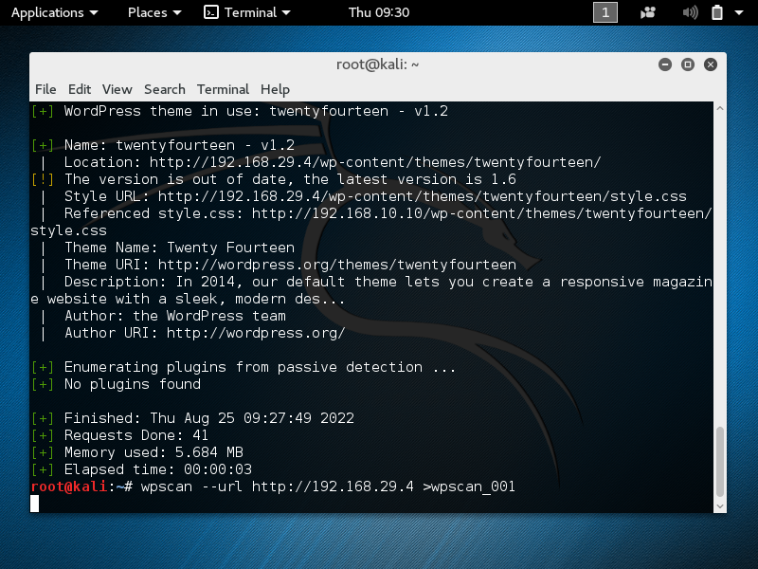

Slide 19
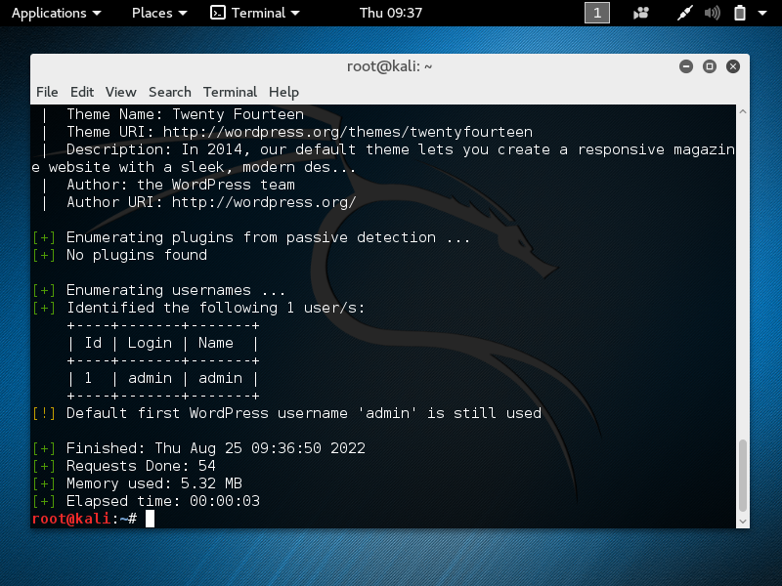
To find the user account names that exist on the website, we use the command-
Command: wpscan - -url http://192.168.29.4 - -enumerate u
Admin account has been detected.

Slide 20
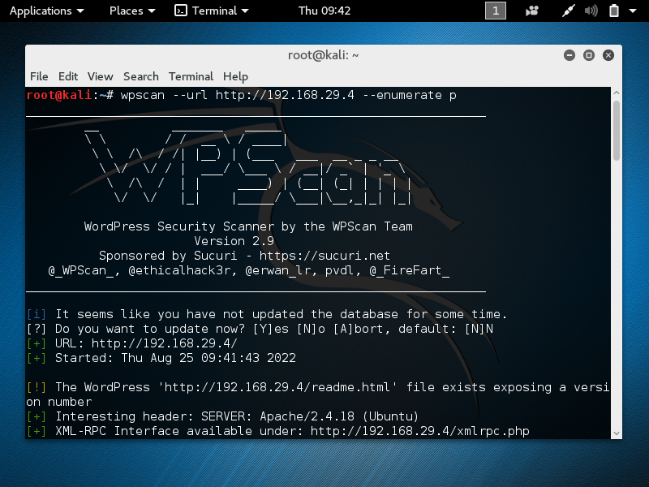
Likewise we can also see the plugins that are installed on this website.
This can be done using the command:
wpscan - -url http://192.168.29.4 - -enumerate p

Slide 21
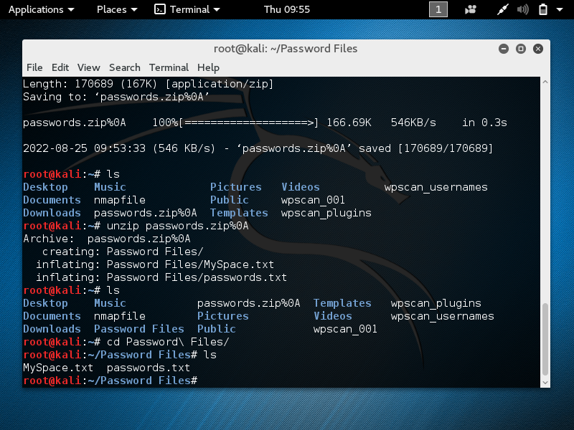
The last step is to identify the password for the admin account.
This can be obtained by making use of password files.

Slide 22
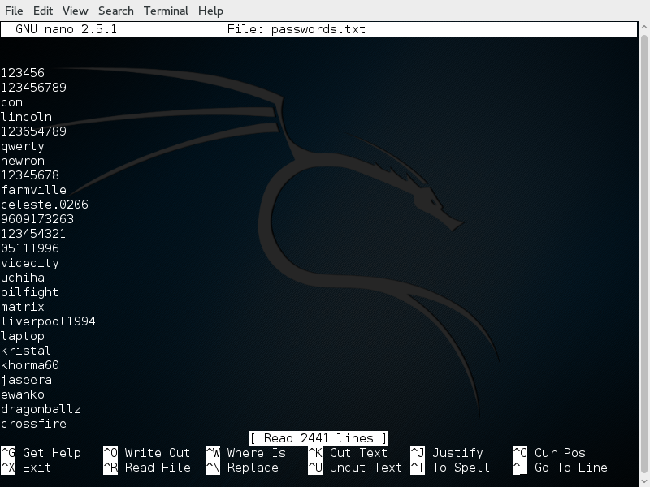
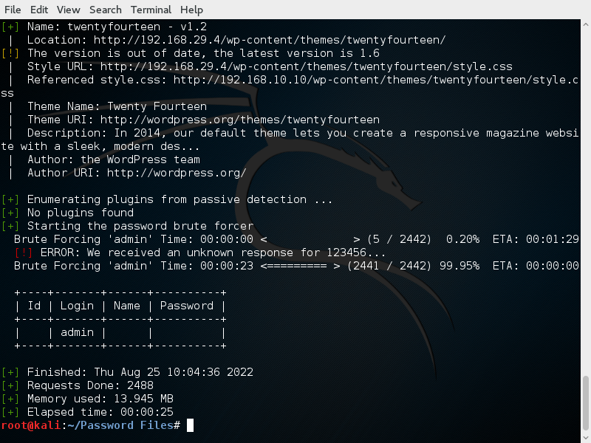
Considering the password files one by one, we proceed to determine the password.
wpscan - -url http://192.168.29.4 - -wordlist ~/Password\ Files/passwords.txt - -username admin

Slide 23
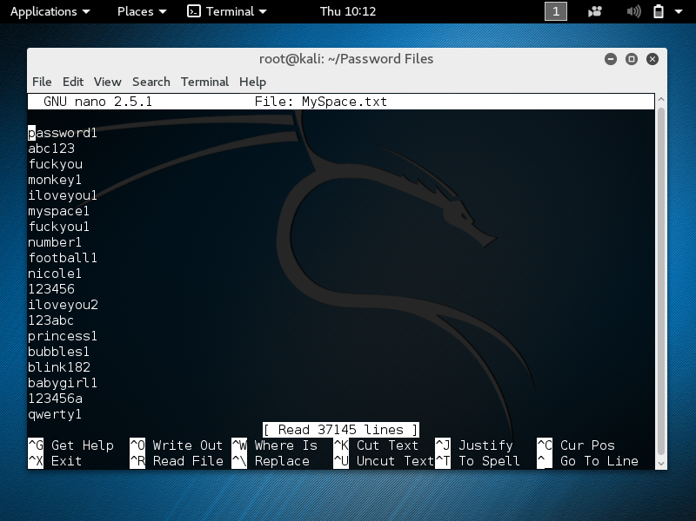
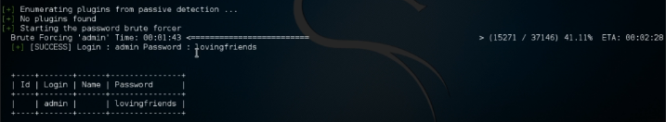
Now, considering a larger password file:
wpscan - -url http://192.168.29.4 - -wordlist ~/Password\ Files/MySpace.txt - -username admin

Slide 24
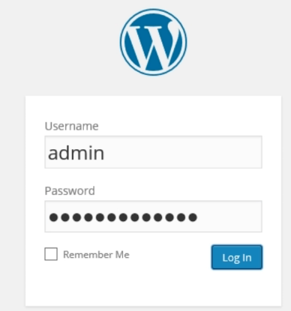
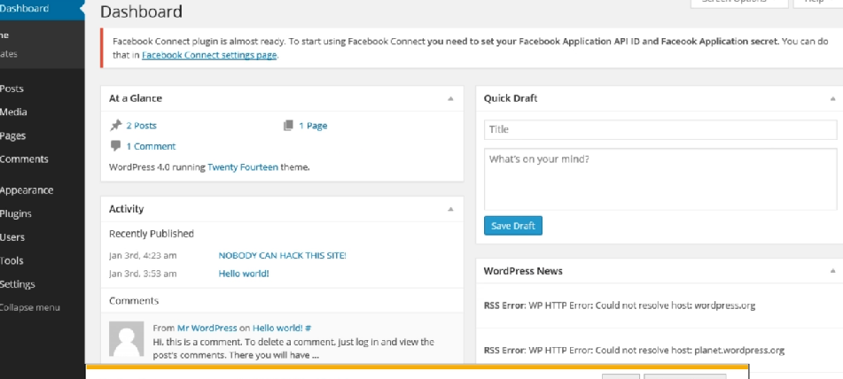
Now we login using admin credentials.

